Slide 1






Understanding
User Prioritization and Comprehension
of Smartphone Permissions
Manila Devaraja
Sameer Patil
University of Utah
This presentation uses images licensed from Adobe Stock.
Notes:
SLIDE 1:
I am Manila Devaraja from the University of Utah.
In this video, I will present our research on the user experience of smartphone permissions managers.

Slide 2
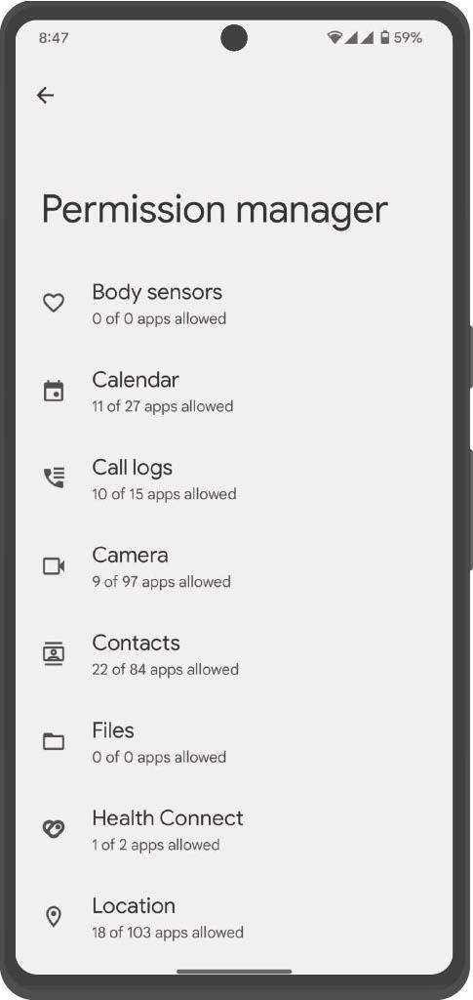
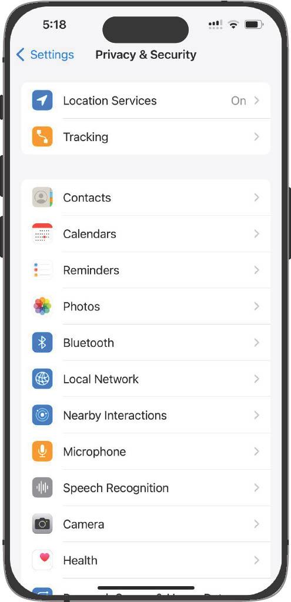
Android 13.0
iOS 17.4.1
Notes:
SLIDE 2:
Permissions manager included in smartphones present numerous permission settings that users can adjust to manage their privacy.
But how important are these permissions to end users?
Do users even understand what each of the permission controls?
We conducted a study to find out.
Specifically, the study addressed three research questions.

Slide 3
RQ1
How do users prioritize the permissions available in the permissions manager?
RQ2
Why do users consider specific permissions important or unimportant?
RQ3
Do users accurately comprehend what each permission controls?
Notes:
SLIDE 3:
How do users prioritize the permissions in terms of their importance?
<CLICK>
What are the reasons for considering specific permissions as important or unimportant?
and
<CLICK>
Do users understand what each permission controls?

Slide 4
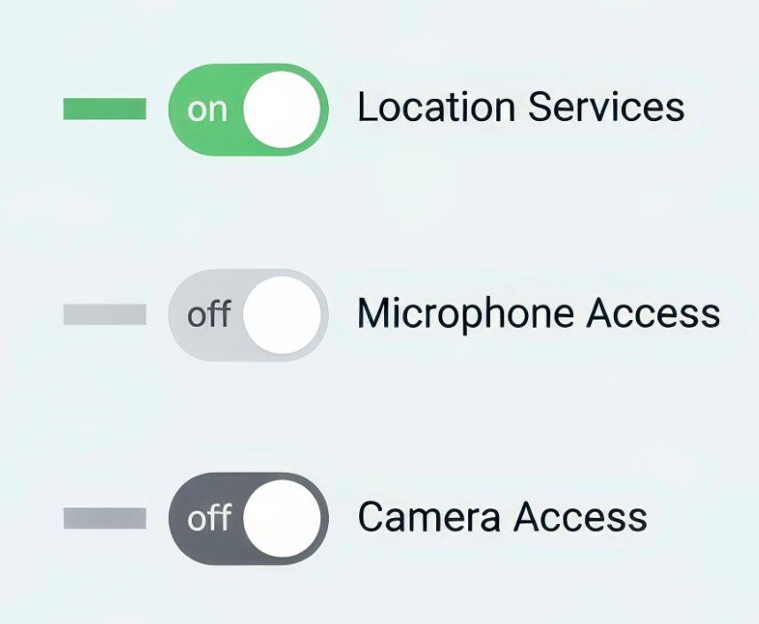
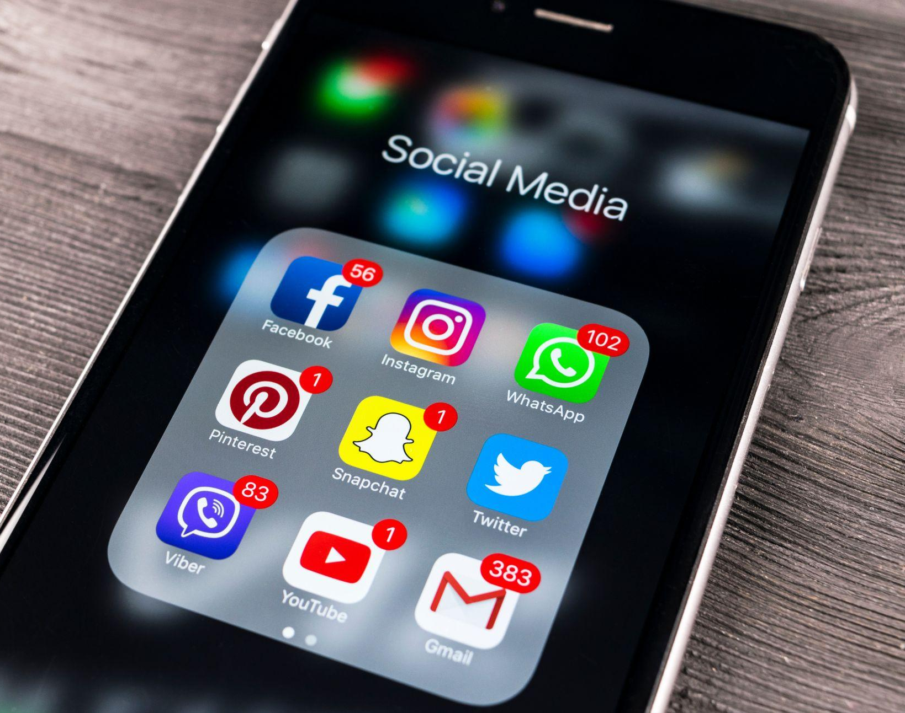
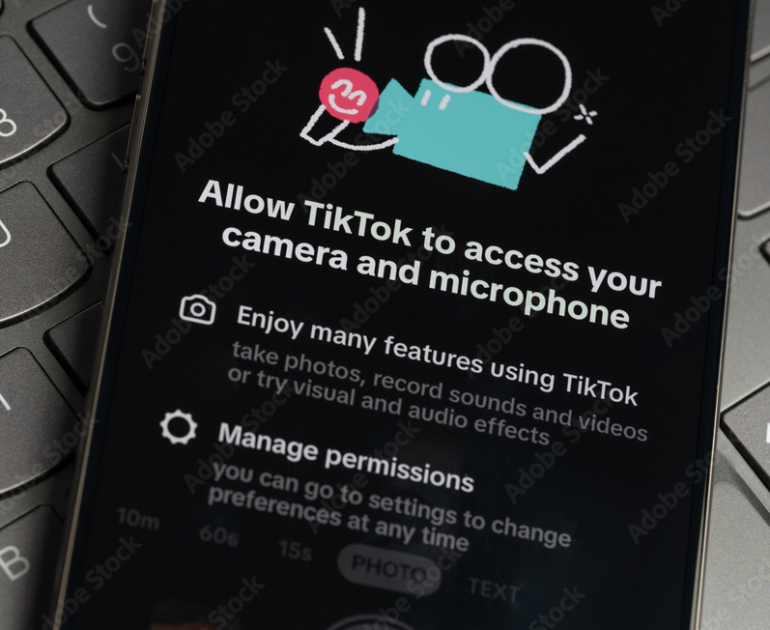
Research on permissions managers is limited.
Explore only a few permissions
Focus on social media apps
Study runtime decisions
Notes:
SLIDE 4:
Existing research on privacy settings has explored only a few permissions or
<CLICK>
focused on specific apps, such as social media or
<CLICK>
decisions users make when presented with permissions dialogs at runtime.
In contrast, our research covered the entire set of permissions included in permissions managers within a single study.

Slide 5
Bluetooth
Body Sensors
Calendar
Call logs
Camera
Contacts
Files and Folders
Focus / Do Not Disturb
Health
HomeKit
Local Network
Location
Microphone
Music and Audio / Media
Nearby Devices
Nearby Interactions
Notifications
Phone
Photos and Videos
Physical Activity / Motion & Fitness
Reminders
Research Sensor & Usage Data
SMS Speech Recognition
Tracking
Wallet
We consolidated permissions from Android 13.0 and iOS 17.4.1 into a superset of 26 permissions.
Notes:
SLIDE 5:
To cover all permissions available in permissions manager, we created a superset of 26 permissions by consolidating permissions available in Android 13.0 and iOS 17.4.1, the latest versions of the two dominant smartphone operating systems at the time of the study.
In the few cases where the same permission was labeled slightly differently in Android and iOS, we combined the variations into a label that could be generally understood independent of OS.
<CLICK>
For example, we used the label Music and Audio / Media to represent the permission labeled by Android as Music and audio and iOS as Media & Apple Music.
If there were large semantic differences in the labels for a permission across the two OSes, we kept both in the superset.
<CLICK>
For example, even though Nearby Devices in Android and Local Network in iOS are connected to the same function, we included both separately.

Slide 6
We used the superset in an online questionnaire.
Screening
Rating Permissions
Ranking Permissions
…
Justification for Rankings
Permission Comprehension
Permissions-related Practices
…
Privacy Concerns
Technical Efficacy
Demographics
Notes:
SLIDE 6:
We included the superset of permissions in an online questionnaire that we used to address our research questions.
After obtaining informed consent, <CLICK>
we screened participants to ensure that they were adults from the United States who used Android or iOS smartphones.
<CLICK>
Participants first rated each permission in the superset in terms of its importance to them, followed by
<CLICK>
providing a ranking of the top five most and least important permissions.
<CLICK>
We asked participants to explain the reasons for ranking permissions as important or unimportant.
<CLICK>
Next, we asked participants to explain their understanding of what a permission controls for three permissions chosen randomly from the set of 26.
<CLICK>
Participants then answered questions about their interactive practices related to permissions.
At the end, we administered standard scales to measure
<CLICK>
privacy attitudes and
<CLICK>
technical efficacy, along with
<CLICK>
standard demographics.

Slide 7
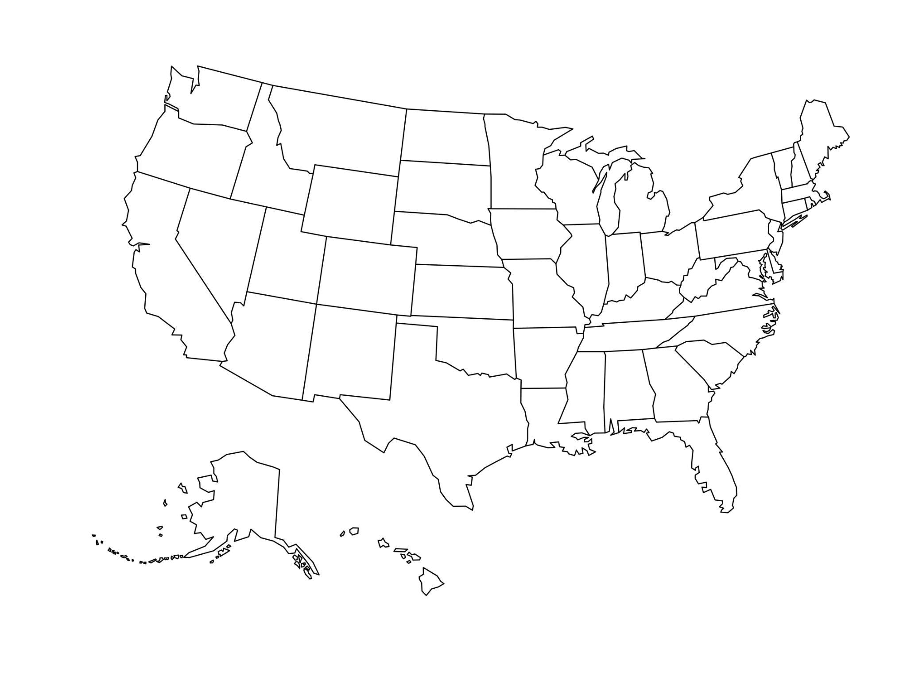





We obtained responses from 151 participants.
53 Men
97 Women
1 Non-binary
120 Android users
Located in the United States
21-72 years old
31 iOS users
Notes:
SLIDE 7:
We administered the questionnaire to participants in the United States recruited via the crowdwork platform Amazon Mechanical Turk.
We obtained 151 valid responses from participants between 21 to 72 years of age.
<CLICK>
Roughly 2/3rds of the participants were women.
<CLICK>
Most of the participants primarily used Android smartphones, but a fifth of the sample were iOS users.

Slide 8
RQ1
How do users prioritize the permissions available in the permissions manager?
Notes:
SLIDE 8:
We first analyzed the ratings and rankings of importance to understand how participants prioritize permissions in terms of absolute and relative importance.
For the presentation:
We first analyszed the rating and ranking of the permissions to understand how users priortiszed permissions in both absolute and relative terms.

Slide 9
Some permissions were universally important or unimportant.
Notes:
SLIDE 9:
We found that some permissions,
<CLICK>
such as Contacts, Camera, and Phone, were considered nearly universally important.
Conversely, some permissions
<CLICK>
such as HomeKit and Body Sensors, were nearly universally deemed unimportant.
The distributions of importance ratings for the permissions in the middle of the figure are more varied, suggesting greater variation regarding perceived importance.
The distribution of the ratings in the middle of the figure is more varied, indicating a greater variation regarding perceived importance.

Slide 10
Importance rankings were mostly aligned with the ratings.
Notes:
SLIDE 10:
When examining the permissions ranked as the top five most or least important, we found them to be mostly aligned with the importance ratings.
For instance, five permissions
<CLICK>
Call Logs, Camera, Contacts, Phone, and Photos and Videos --- out of the top six in terms of ratings and rankings of importance were the same.
Were in top six in rating and ranking.
Similarly, four permissions
<CLICK>
-- Body Sensors, HomeKit, Nearby Devices, and Nearby Interactions -- were in the bottom six in terms of ratings as well as rankings of importance.

Slide 11
RQ2
Why do users consider specific permissions important or unimportant?
Notes:
SLIDE 11:
To answer RQ2, we employed thematic analysis of the open-ended text explanations of the participants to understand the reasons for their prioritization of permissions.
To answer RQ2, we requested participants to give reasons for considering the permissions as important or unimportant. The answers were coded using thematic analysis.

Slide 12
Participants ascribed importance based on multiple factors.
Personal use
“So I’m able to use Maps, Weather, Uber.”
— (Location) [P053, Android, Man, 69]
“Calendar is very important because it helps in event management.”
— (Calendar) [P032, Android, Woman, 40]
Notes:
SLIDE 12:
We found that participants ascribed importance to permissions based on a combination of factors.
Personal use of the permission was one of these factors.
P053 considered the location permission important to be able to use Maps, Weather, and Uber apps, while P032 said that "calendar is very important because it helps in event management."

Slide 13
Participants ascribed importance based on multiple factors.
Personal use
“I may not frequently engage in activities or use apps that rely on nearby device interactions or proximity-based services.”
— (Nearby Interactions) [P099, iOS, Woman, 34]
“I think it can’t give a proper reading. So I don’t use it.”
— (Physical Activity / Motion & Fitness) [P117, Android, Woman, 34]
Notes:
SLIDE 13:
Conversely, permissions that were rarely or never used were deemed irrelevant and unimportant.
P099 said that Nearby Interactions was unimportant to her because she may not frequently engage in activities or use apps that rely on nearby device interactions or proximity-based services.
Similarly, P117 found the Physical Activity / Motion & Fitness permission to be unimportant because she didn't believe that the sensors could give a proper reading, so he didn't use the functionality.

Slide 14
Participants ascribed importance based on multiple factors.
Privacy concerns
“Because I want control over who and what has access to my call logs. It’s not anyone’s business whom I call or who calls me.”
— (Call Logs) [P096, Android, Man, 50]
“…it could reveal all the [phone] numbers of my friends and family who would be exposed to all the threats.”
— (Phone) [P111, Android, Woman, 29]
Notes:
SLIDE 14:
A second factor behind considering a permission to be important was perceived sensitivity and privacy concerns regarding the data it controlled.
Privacy concerns regarding the data controlled by a permission made participants consider the permission to be of high importance.
P096 said that the Call Logs permission is important because he wants control over who and what has access to his call logs. He felt that whom he calls or who calls his is not anyone eles's business.
We noted that many participants expressed privacy concerns not just for themselves but also for others whose data is stored on their devices.
As P111 noted, the Phone permission could reveal the phone numbers of her friends and family who could then be exposed to threats.

Slide 15
RQ3
Do users accurately comprehend what each permission controls?
Notes:
SLIDE 15:
Finally, we examined open-ended text responses of the operational function of a permission to check whether the participants correctly understood what a permission controls.
To answer RQ3, we asked participants to explain their understanding of what a permission controls through text-box answers, which were then coded using thematic analysis.

Slide 16
Participants exhibited operational misunderstandings.
“Access to my money and transaction data.”
— (Wallet) [P024, Android, Man, 37]
“Usage data warns me if I use more of my data.”
— (Research Sensor & Usage Data) [P006, iOS, Woman, 25]
Notes:
SLIDE 16:
We found that a quarter of the explanations of the participants regarding what a permission controls exhibited a complete or partial misunderstanding of how the permission operates.
Many misunderstandings occurred because the label for the permission was not sufficiently precise, which made it difficult to infer what exactly it controlled.
P024 mistakenly assumed that the Wallet permission controls access to data about his money and financial transactions.
P006 misunderstood the term ‘Usage Data’ in Research Sensor & Usage Data and believed that the permission was meant to warn her for exceeding her allocated data use.
P6 misunderstood that access to Research Sensor & Usage Data would warn her about excessive data usage.
Our findings point to a number of ways in which the user experience of current permissions managers can be improved.

Slide 17

All permissions visible
Important permissions visible
Notes:
SLIDE 17:
Instead of presenting all permissions, permissions managers could
<CLICK>
enable users to choose the permissions they want to keep visible based on which they find most relevant and useful.
Enable users to choose the permissions they want to manage, which they find relevant and useful

Slide 18

Static permissions order
Personalized permissions order
Notes:
SLIDE 18:
Instead of presenting permissions to all users in the same order, the list of permissions can be
<CLICK>
presented in an order personalized according to what a user finds most important.
Permission managers could personalize the order in which the permissions are presented based on the importance to the user.

Slide 19

Ambiguous labels
Clear labels and visuals
Notes:
SLIDE 19:
The labeling and descriptions of permissions within the interface can be improved to
<CLICK>
provide a clearer text and visual depiction of what the permission controls.
For improving comprehension, the labels and description of the permissions withing the interface can be imporved to provide clear labels and visual depciations of what the permisisons controls

Slide 20



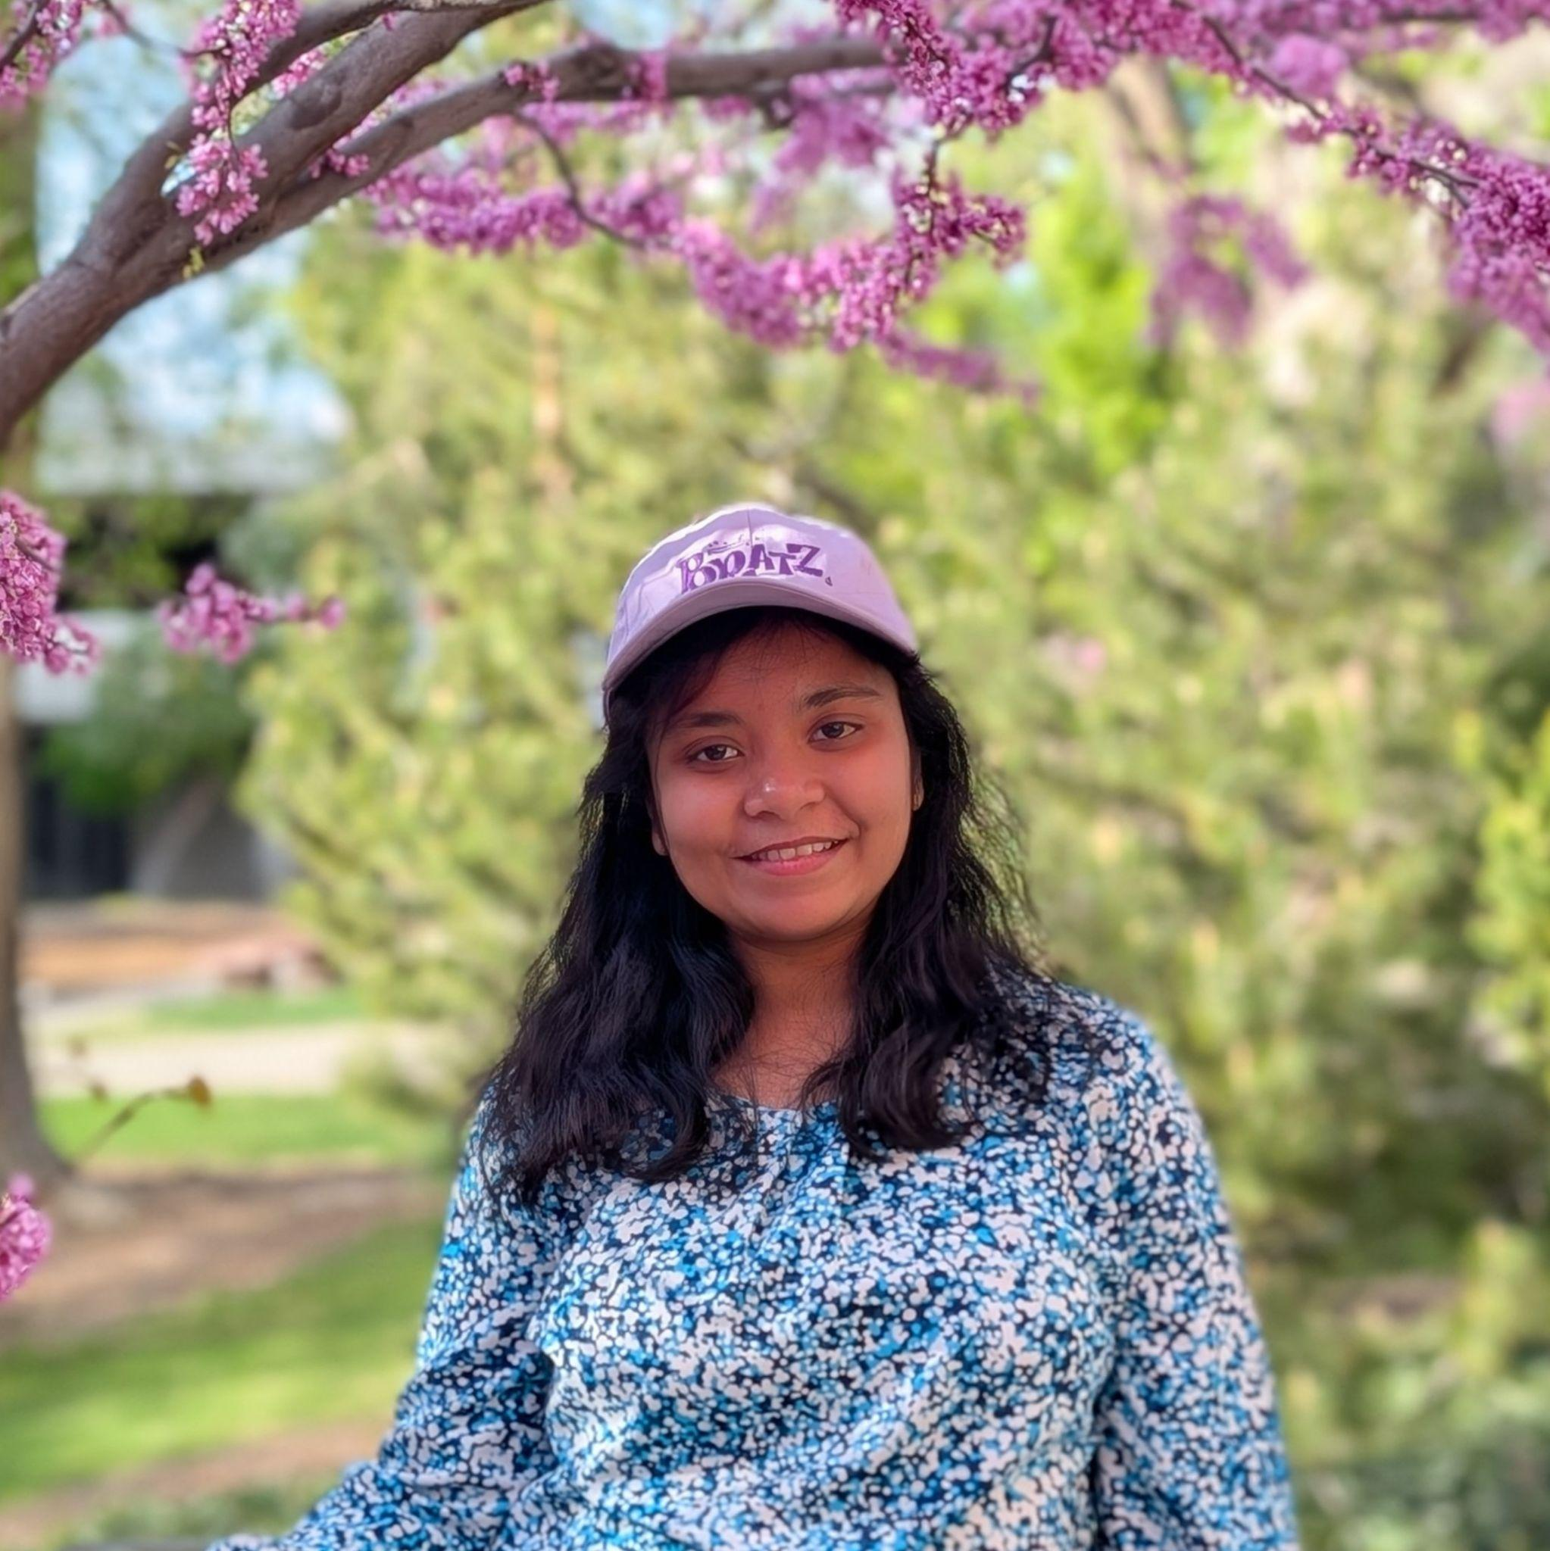






We would like to thank…
Khawar Murad Ahmed
Study participants
Ellery Gresham
Farhana Khan
Sara Nurollahian
Anonymous peer reviewers
Brandt Redd
Hrishikesh Pachlag
National Science Foundation
Annabelle Warner
Notes:
SLIDE 20:
Lastly, We are grateful to a number of people for their help with various aspects, such as coding open-ended responses and providing detailed comments on paper drafts.
In addition, we wish to thank
<CLICK>
the participants of the study for their responses, the anonymous peer reviewers for their feedback, and the National Science Foundation for funding the project.

Slide 21
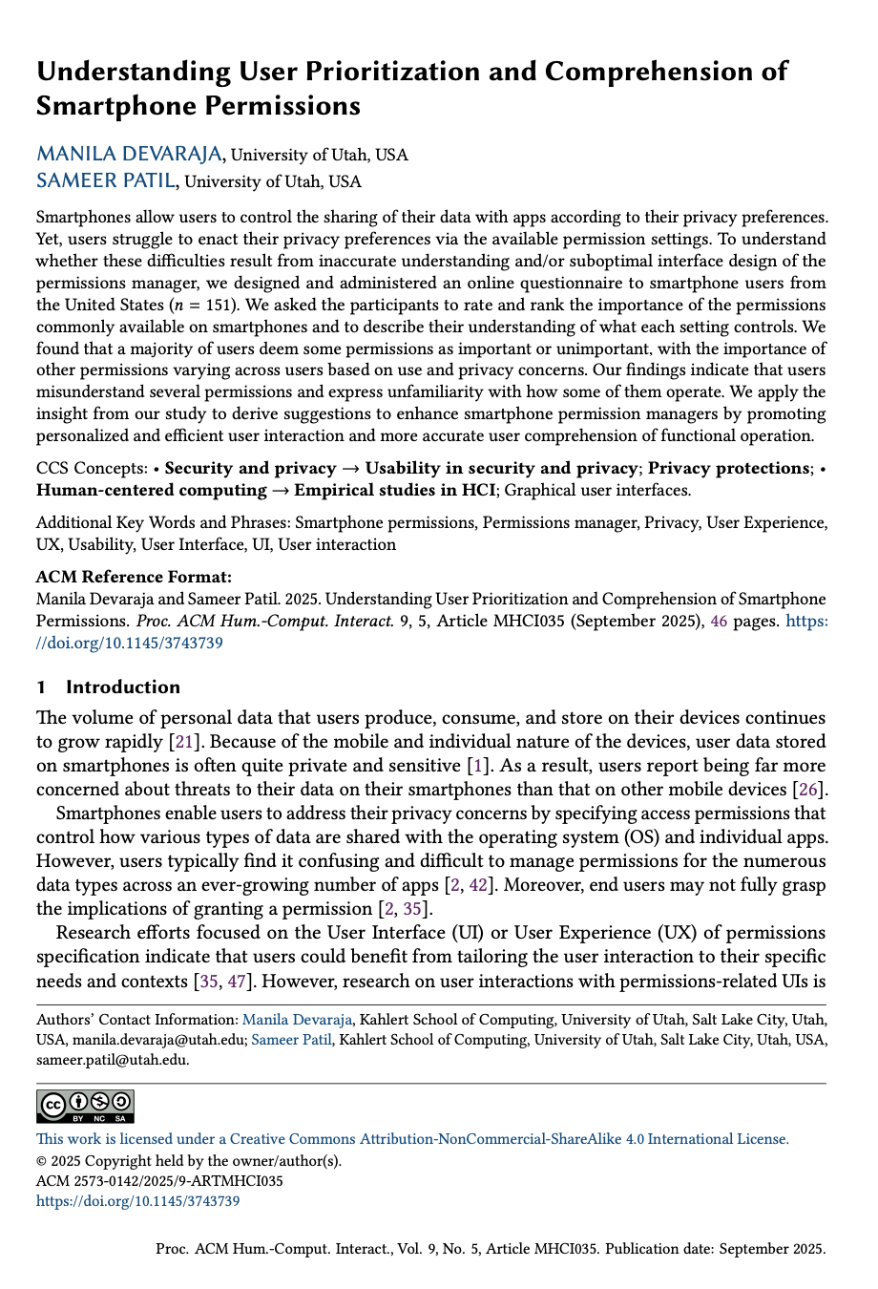


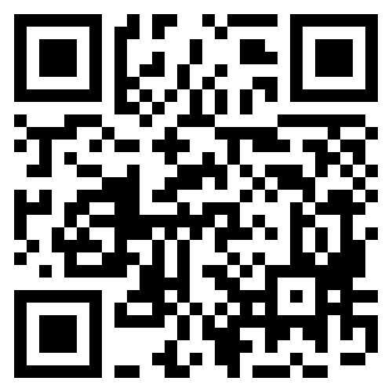
The importance of a smartphone permission varies across users.
Users may not always understand what a permission controls.
The user experience of permissions managers requires enhancements for better alignment with user preferences.
Understanding User Prioritization and Comprehension of Smartphone Permissions
https://doi.org/10.1145/3743739
Manila Devaraja
manila.devaraja@utah.edu
Manila Devaraja
Sameer Patil
sameer.patil@utah.edu
Notes:
SLIDE 21:
In summary, we found that the importance of a permission can vary across users and permissions.
Our work points to several enhancements to the user experience of current permissions managers for better alignment with user preferences.
For more in-depth information on our findings, we encourage you to read the paper.

